Slide 1
POLYMORPHISM

Slide 2
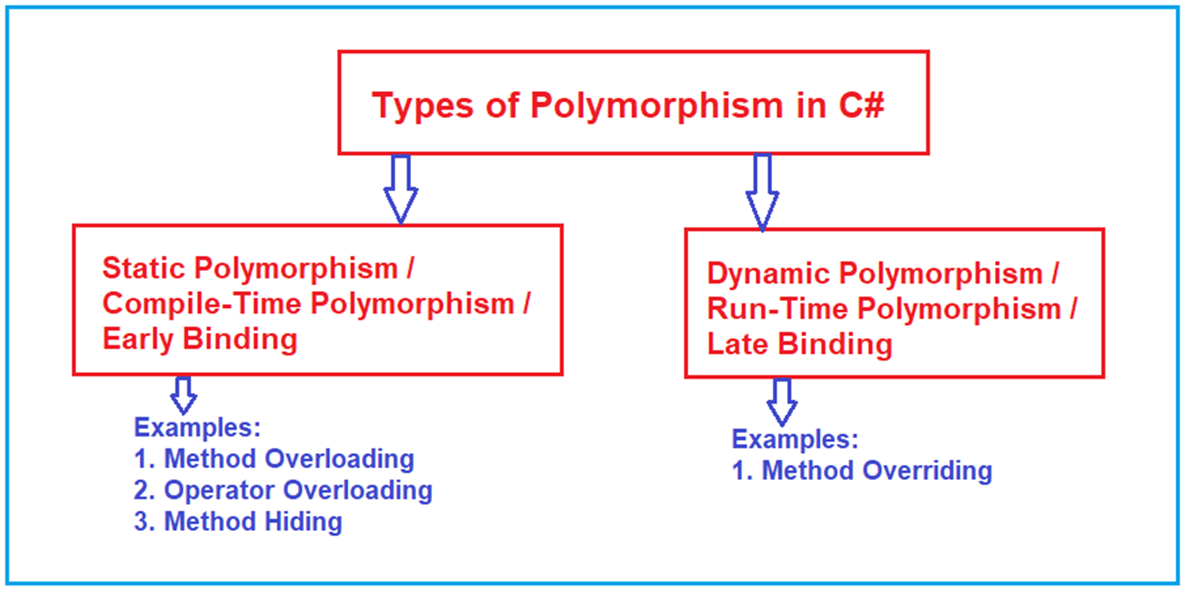

Slide 3
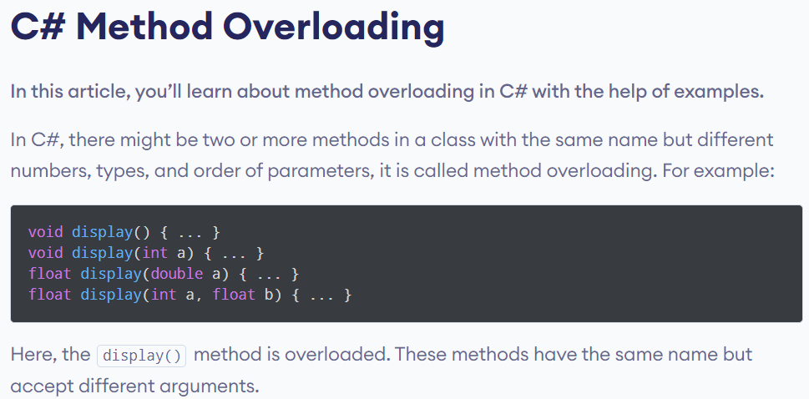
Test
Test
Find the examples in the Added Sources at the Last slide

Slide 4
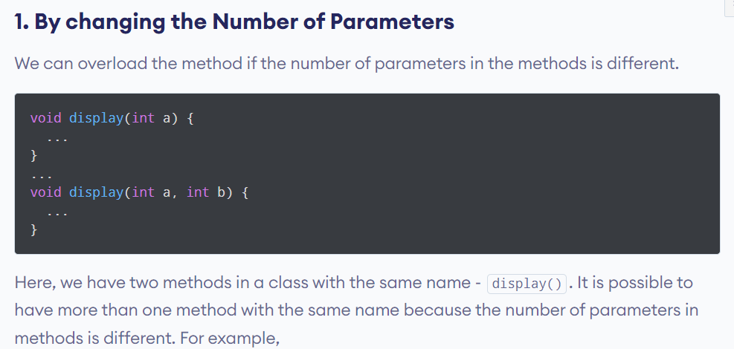
Test

Slide 5
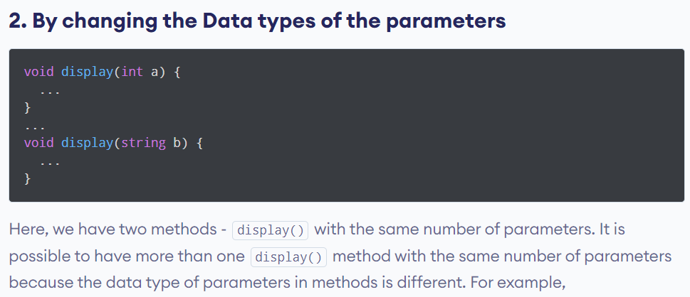
Test
Test

Slide 6
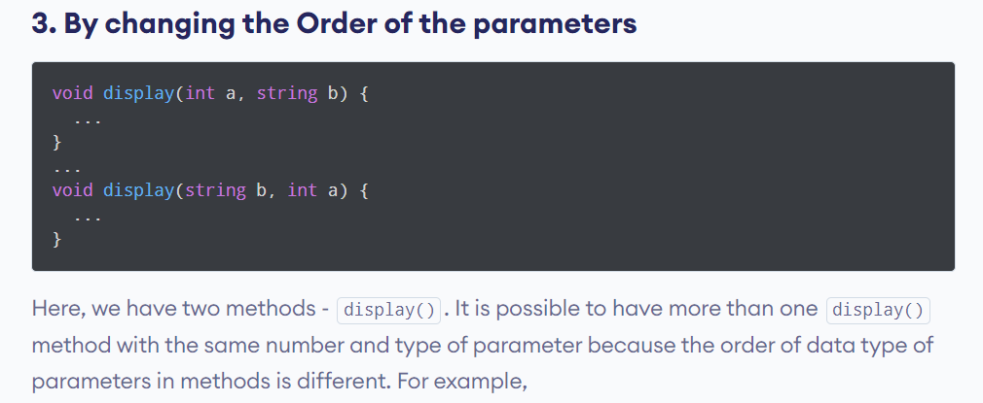
Test
Test

Slide 7
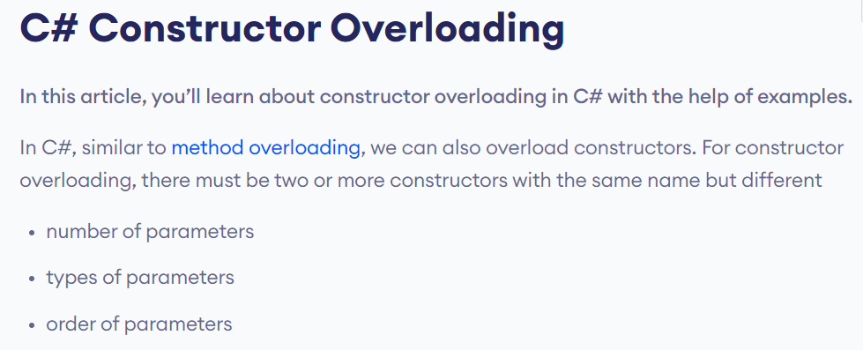
Test
Test

Slide 8
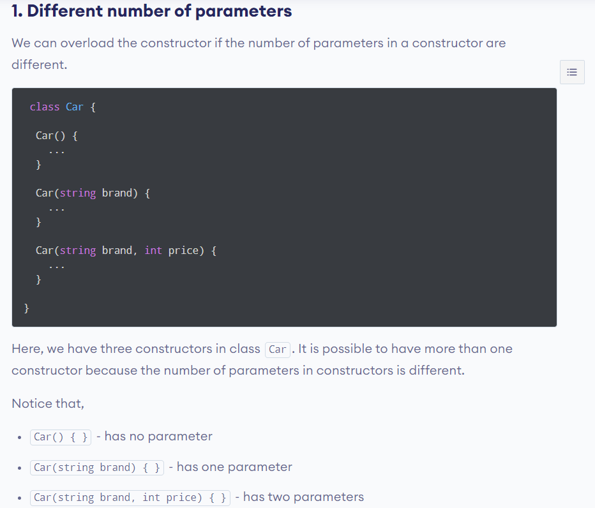
Test
Test

Slide 9
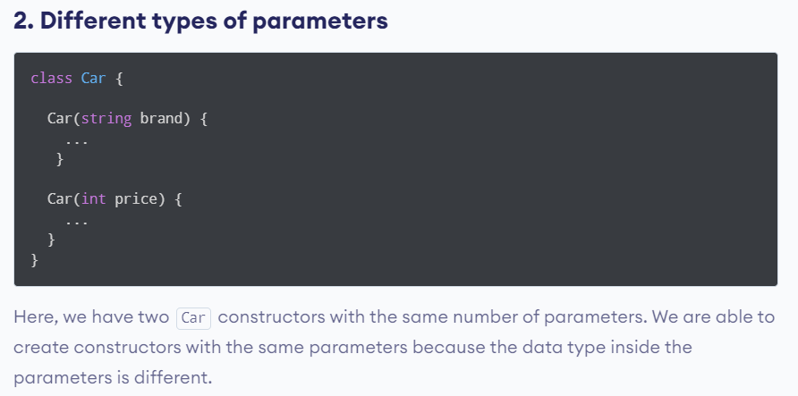
Test
Test

Slide 10
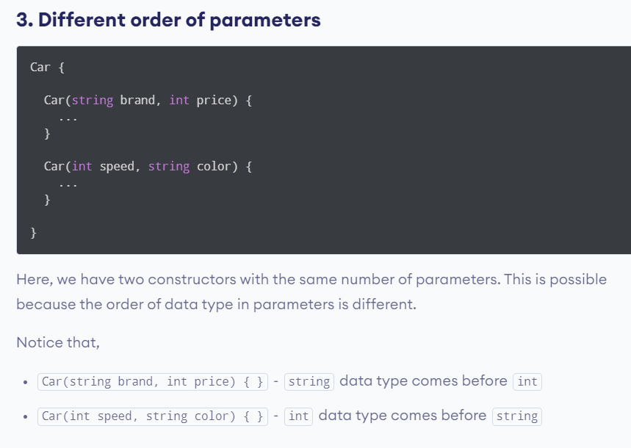
Test
Test

Slide 11
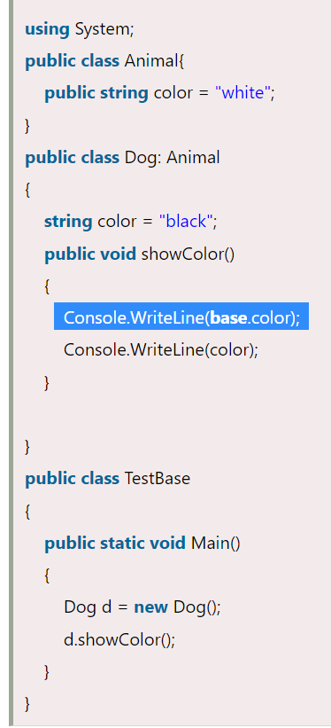
C# base keyword: accessing base class field

Slide 12
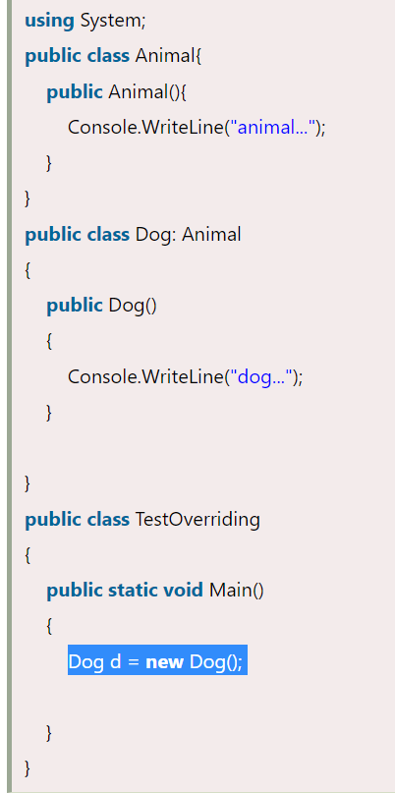
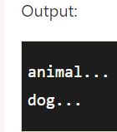
Whenever inherit the base class, base class constructor is internally invoked

Slide 13
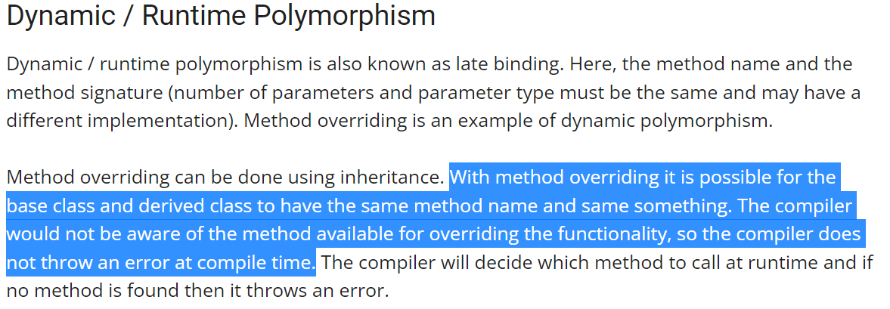

Slide 14
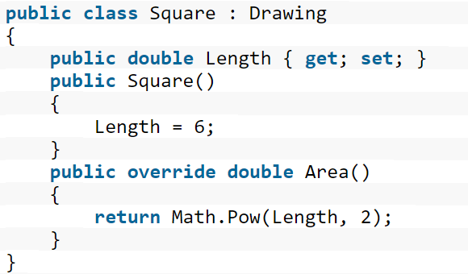
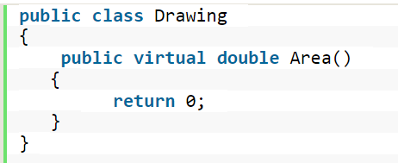
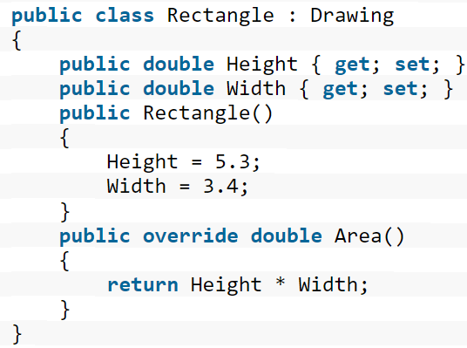
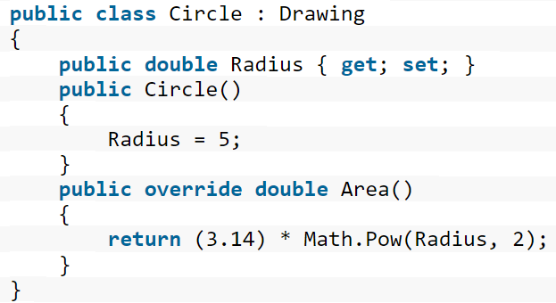


Main Class
Inner View

Slide 15
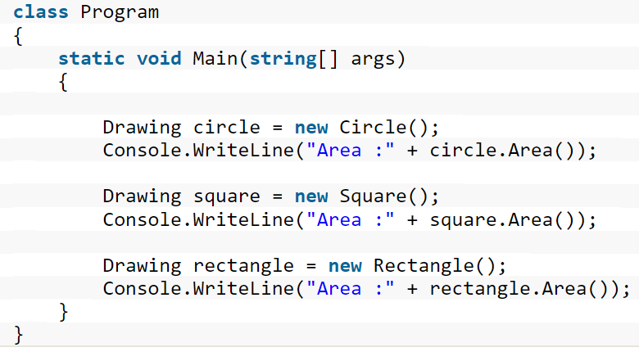

Slide 16
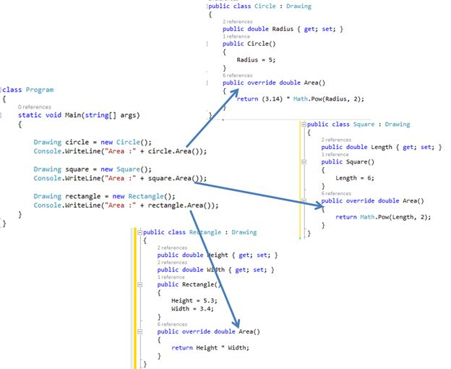

Slide 17
If none of its members are marked virtual, derived classes will not be able to overrides its members. (Example A)
//Example A -- Cannot have members overridden because none are marked virtual
public class Dog
{
public string Name {get;}
public int Age {get;}
public void Bark() { //Do stuff}
}

Slide 18
If you want to prevent it from being inherited, you can mark the class as sealed. (Example B)
//Example B -- cannot be INHERITED FROM AT ALL -- so members cannot be overridden
public sealed class Cat
{
public string Name {get;}
public int Age {get;}
public void Meow() {//Do Stuff}
}

Slide 19
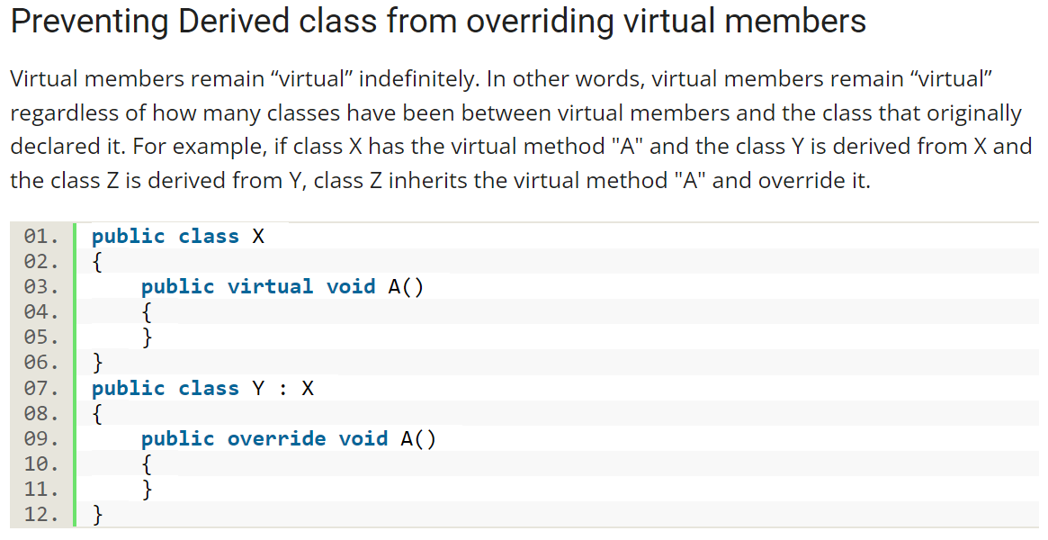
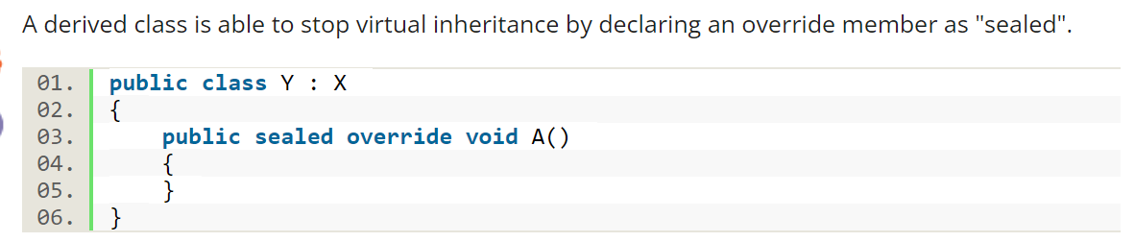

Slide 20

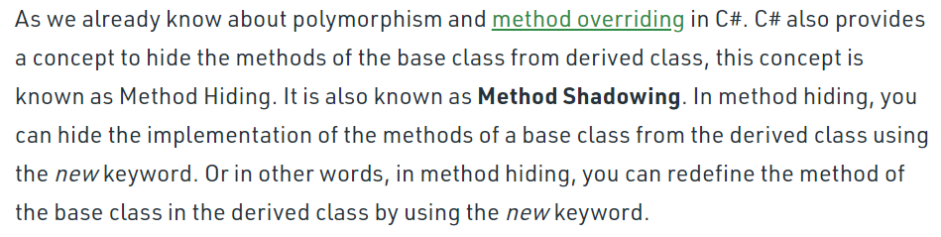

Slide 21
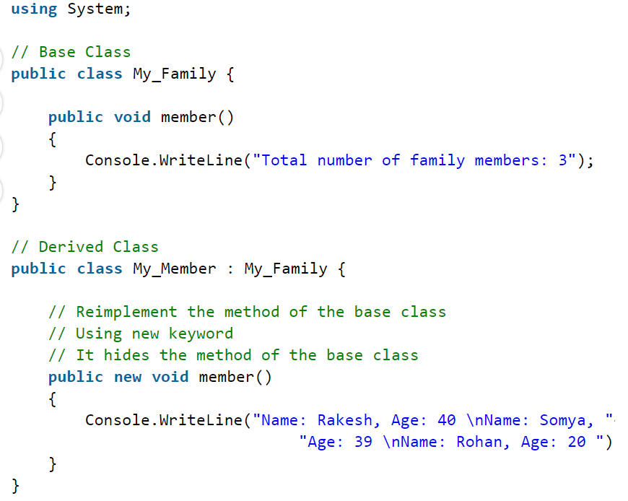


Slide 22
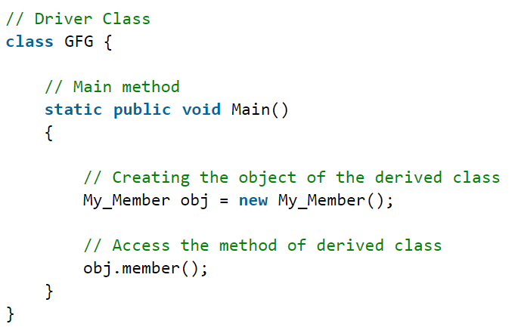
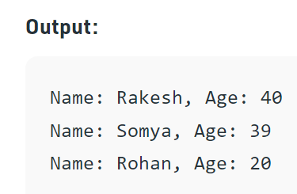
What will happen if we do not use the new keyword?

Slide 23
Sources
https://www.programiz.com/csharp-programming/method-overloading
https://www.geeksforgeeks.org/c-sharp-method-overloading/
also See the “RECOMMENDED ARTICLES” at the bottom of geeksforgeeks
https://www.c-sharpcorner.com/UploadFile/ff2f08/understanding-polymorphism-in-C-Sharp/#:~:text=Polymorphism%20is%20a%20Greek%20word,implementations%20with%20the%20same%20name.
https://www.geeksforgeeks.org/method-hiding-in-c-sharp/

